Slide 1
Category review: Customer Insights
June 2020
Retail Analytics
Brand note: If client logo is not required, use alternate title page layout right click slide thumbnail > Layout > Title

Slide 2
Notes:
To view Privacy video explaining how important data privacy is to Quantium, please click here: https://www.youtube.com/watch?v=Zq1QDAkoRzU
or here Q:\Company Reference\Brand & Design\Brand videos\Q Privacy.mp4
At Quantium, we believe that data is the behavioural footprint of humanity and that it has to be treated with the utmost care and responsibility.
Histories, attitudes, indeed lives are stored within it in ways that aren’t always apparent – and that’s what makes its potential so powerful.
To work with it responsibly, sensitively, we set ourselves the highest data privacy protection and governance standards.
We have spent 17 years perfecting privacy-by-design and secure-by-design principles. Central to this is not holding any personally identifiable information about people –
we neither receive it, and put the necessary protections in place to be unable to decipher it.
Every aspect of handling data is safeguarded: from its de-identification, to its encryption – data security is paramount and of the highest grade.
We pride ourselves on gaining the trust of iconic organisations around the world through years of securely working with their data,
and in turn the trust that builds with their stakeholders.

Slide 3
Executive summary
01
Data Analysis & Customer Insights
This report presents a detailed analysis of chip sales data across Quantium's retail network for the 12-month period from July 2018 to June 2019. The analysis examines sales trends, product preferences, and customer purchasing behaviour across different life stages and premium-tier segments.
02
Uplift Testing & Experimentation Analysis
This report evaluates whether a new store layout was introduced in three trial stores. Stores 77, 86, and 88 had a meaningful impact on chip sales and customer counts between February and April 2019. The analysis was led by Julia, the chip category manager, to inform a decision on whether to roll out the layout to other stores in the network.
To measure impact fairly, each trial store was matched with a similar "control store" that did not change its layout during the same period. By comparing what happened in the trial stores against what we would have expected based on the control stores, we can isolate the effect of the layout change from broader market trends.

Slide 4
01
Data Analysis & Customer Insights

Slide 5
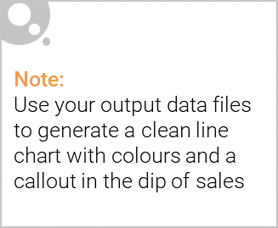
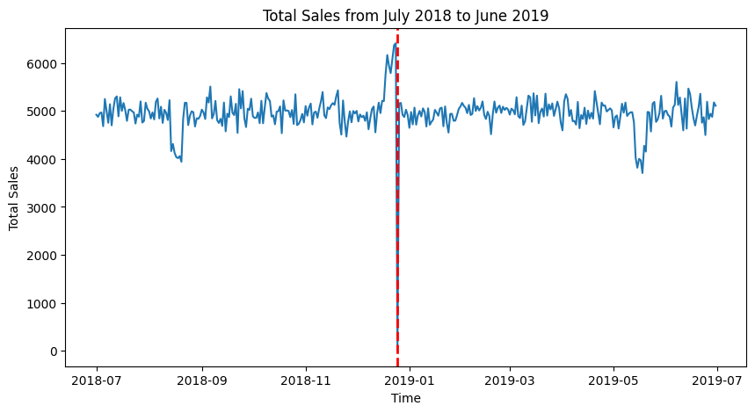
A Full Year of Chip Sales (July 2018 – June 2019)
Christmas Day (Dec 25): Zero sales recorded. All stores closed. Critical for stock planning around this date
364
Days of Sales Data
DEC
Peak Sales Month

Slide 6
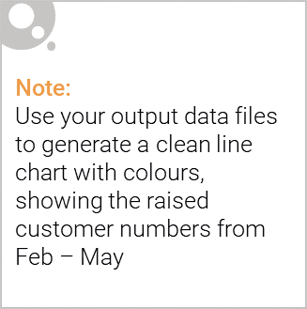
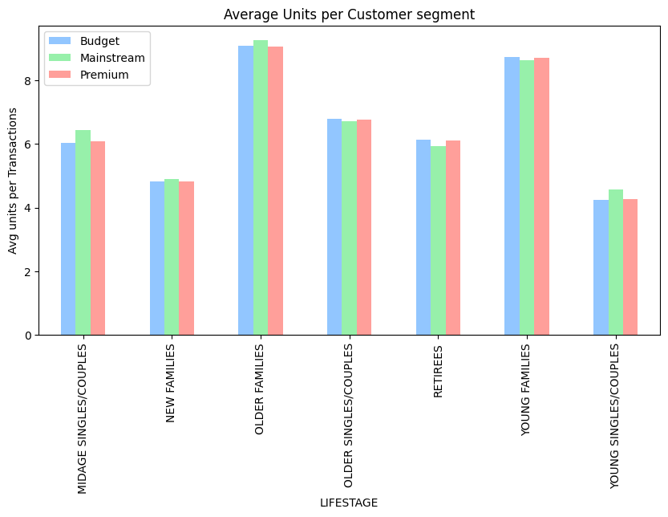
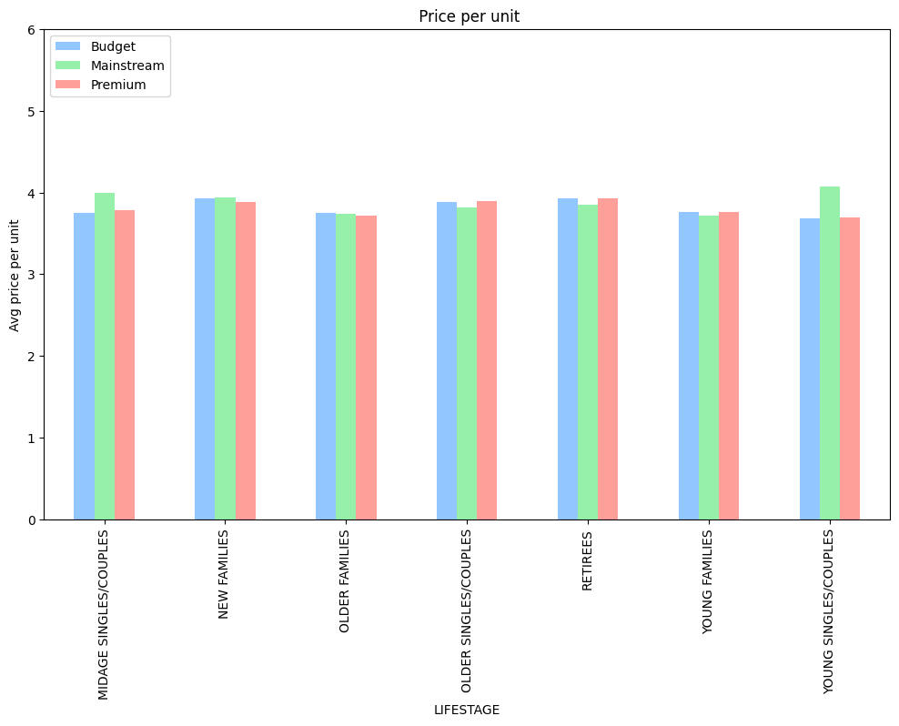
How Different Segments Buy: Volume & Price
Families buy in bulk
Mainstream pay more
Older & Young Families buy significantly more bags per customer, targeting multi-pack deals.
Mainstream Young/Mid-Age singles pay $0.30 more per bag (statistically significant, p < 0.05)

Slide 7
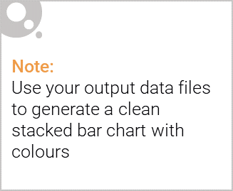
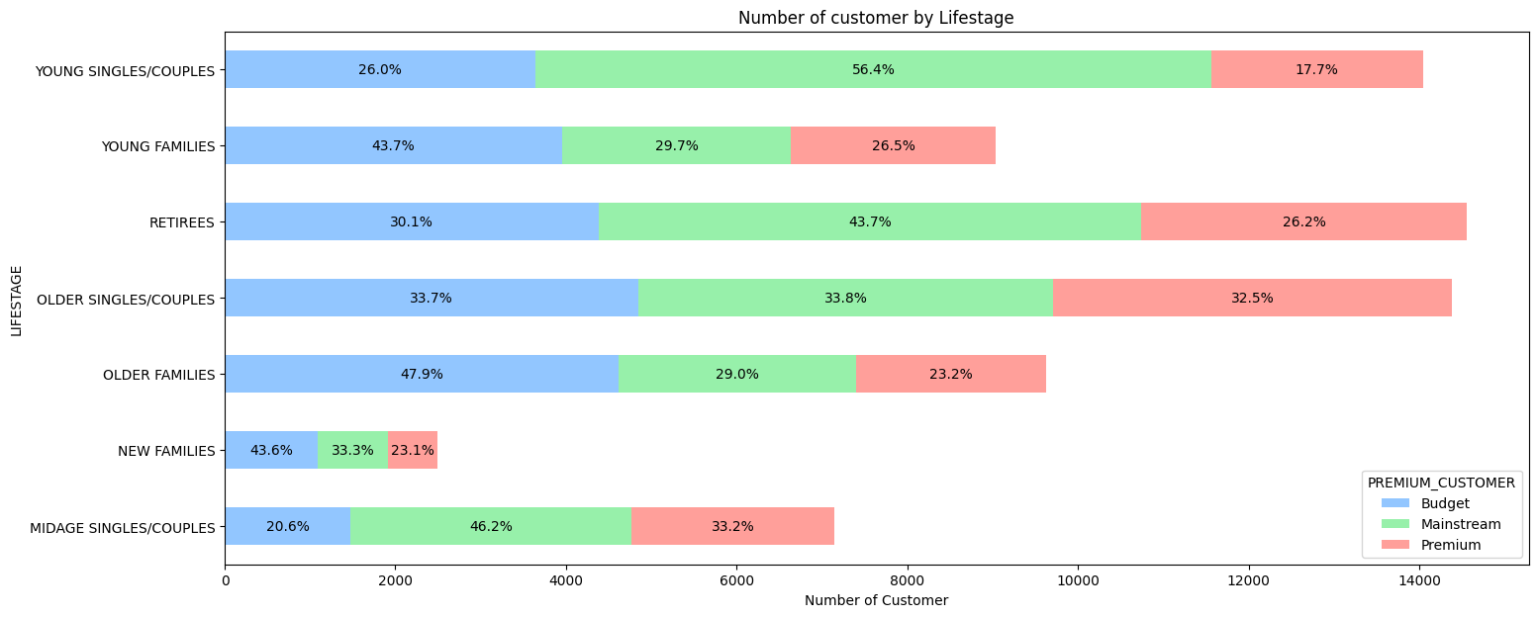
Editable (delete this)
Who Spends the Most on Chips?
Budget Older Families: high revenue despite fewer customers, they buy more per trip
#1
Budget
Older Families
Buy the most bags per visit
#2
Mainstream Young
Singles/Couples
Largest customer group
#3
Mainstream
Retirees
Loyal, consistent spenders

Slide 8
02
Uplift Test & Experimentation Analysis

Slide 9
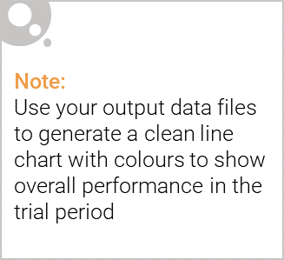
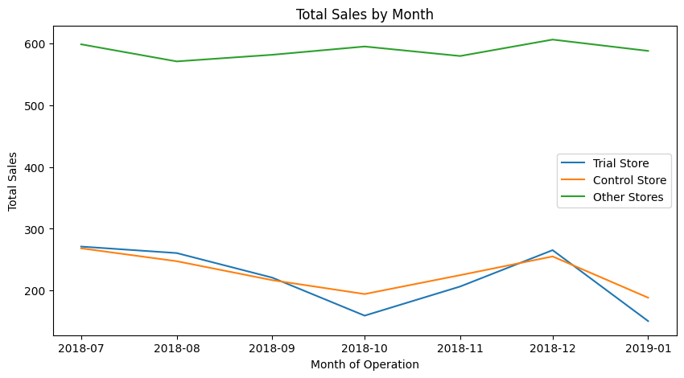
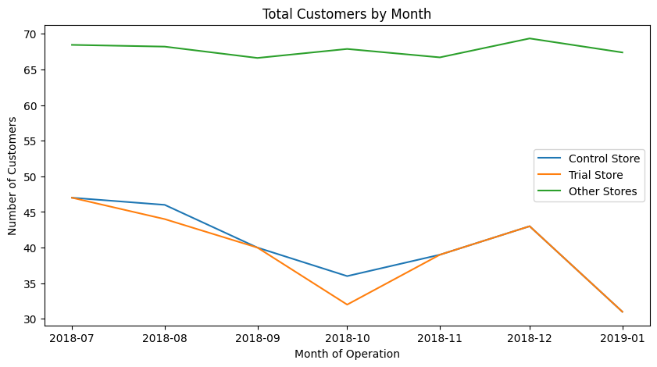
Store 77 vs Control Store 233 – Trial Results
Store 77 was paired with Store 233 as its control. The two stores showed very similar sales patterns and customer volumes in the pre-trial period, making Store 233 an ideal comparison.

Slide 10
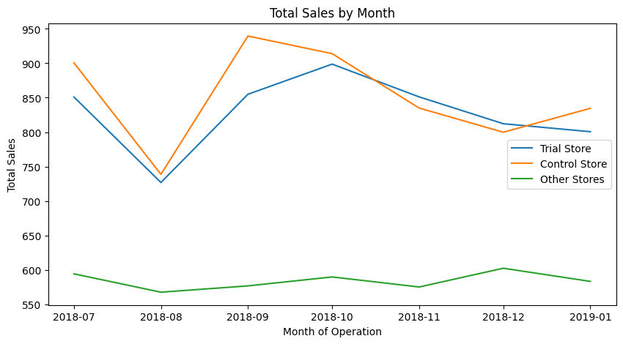
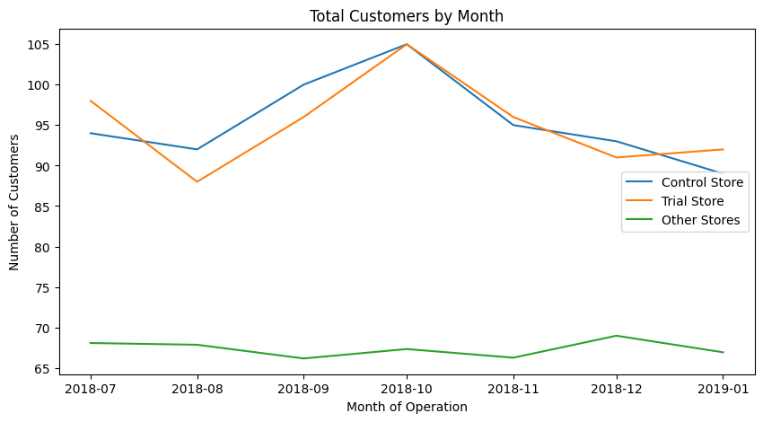
Store 86 vs Control Store 155 – Trial Results
Store 86 was paired with Store 155 as its control. Of all stores evaluated as potential matches, Store 155 showed the strongest combination of sales correlation and magnitude similarity to Store 86 in the pre-trial period.

Slide 11
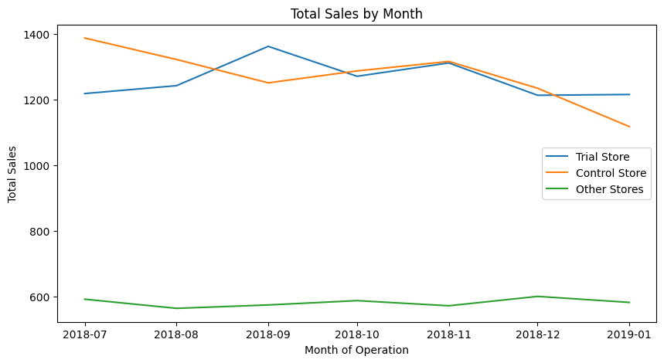
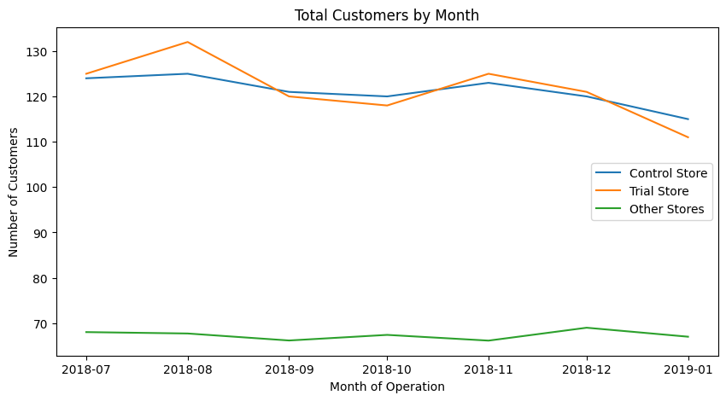
Store 88 vs Control Store 237 – Trial Results
Store 88 was paired with Store 237 as its control, after evaluating Store 237 against several other candidates. Store 237 was selected because it most closely mirrored Store 88's pre-trial sales trajectory and customer count patterns.

